Slide 1
Comparison of YOLO with Anchor-Free Object Detection Model (FCOS)
GNR 638 Course Project
Prathamesh Sachin Pilkhane
Pulkit Agarwal
Shashwat Garg

Slide 2
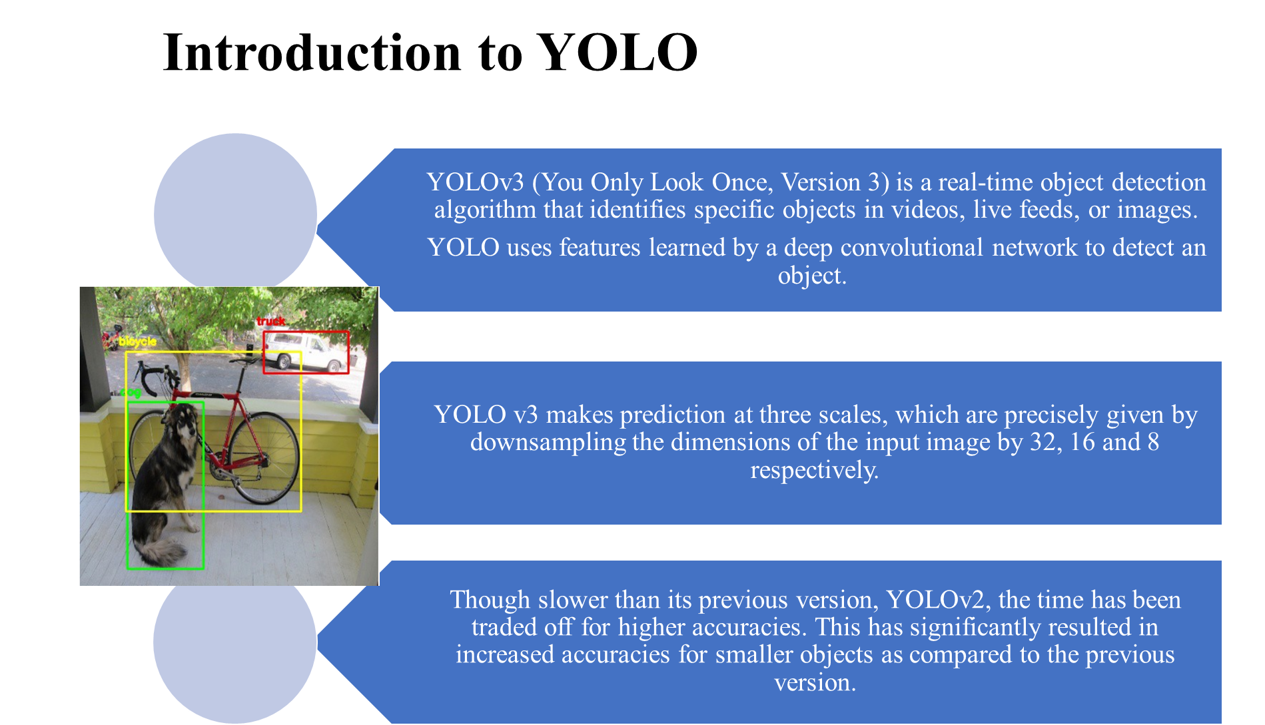

Slide 3
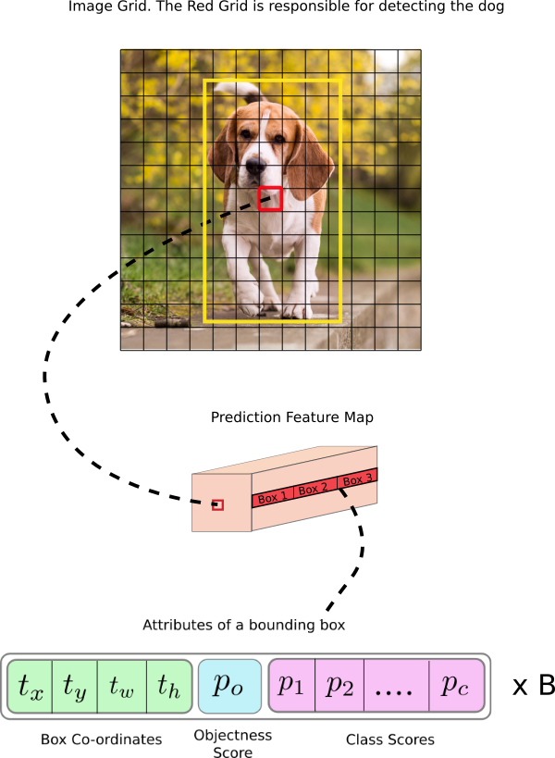
Yolo Architecture
YOLO v3 uses a variant of Darknet, which originally has 53 layer network trained on Imagenet. For the task of detection, 53 more layers are stacked onto it, giving us a 106 layer fully convolutional underlying architecture for YOLO v3. This is the reason behind the slowness of YOLO v3 compared to YOLO v2.
Being a model based on anchor boxes, YOLO v3, in total uses 9 anchor boxes, 3 for each scale.

Slide 4
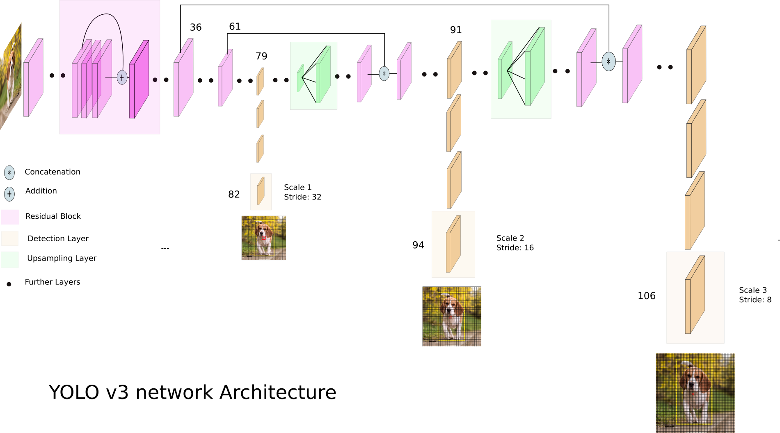
YOLO Architecture

Slide 5
Results of Training on a custom Dataset
We have modified the Optimizer in YOLO model. We now use the Adam optimiser which allows us to converge faster and obtain better loss convergence.
We are able to reach a final moving average loss of 1.4.
We trained on a dataset of 160+ kangaroos.
The next slide demonstrates the identifications of kangaroos in the various images.

Slide 6
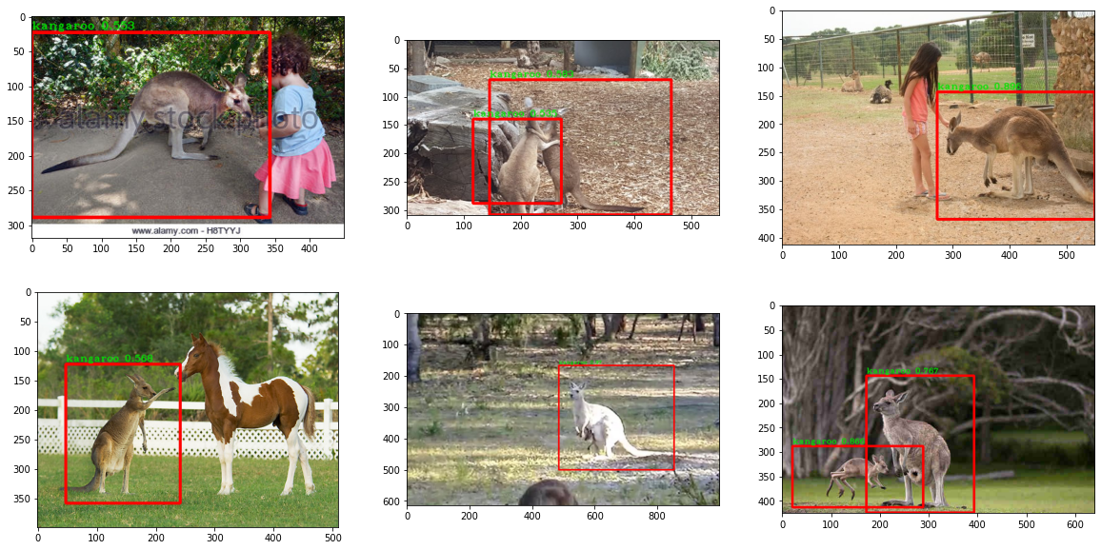

Slide 7
FCOS Introduction
Since the advent of convolutional neural networks, we have seen the the dominance of anchor base networks such as Faster-RCNN, RetinaNet and SSD. FCOS is one of the best object detection networks which is completely anchor-free and this provides us with an alternate way to think about object detection.
There are several advantages to this. Preset anchors require manual tuning on the scale, aspect ratio and number of anchors. FCOS is also considerably faster than YOLO during testing.
FCOS mainly has these characteristics-
Anchor free- no cumbersome IoU matching calculation and preset anchors.
Proposal free- one stage detection.
Computes per-pixel prediction in a fully convolutional manner: the number of detection prediction equals the size of feature maps spatially.

Slide 8
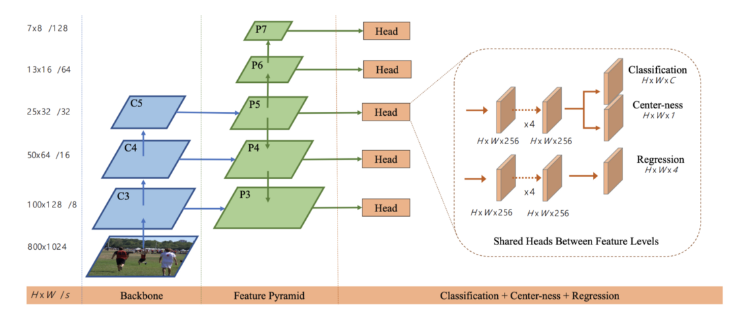
Architecture OF FCOS
FCOS is based on the Feature Pyramid Model and thus, aggregates multi-level features from the backbone as a pyramid.
The outputs are then fed through a subnetwork consisting of 3 branches: classification, center-ness and regression.
Takes an image of dimension [B, H, W, 3]. Multi-scale features are extracted from any exiting encoder, such as DenseNet or ResNet, as a feature extractor.

Slide 9
Loss and Training in FCOS
FCOS has 3 measures of Loss-
Centeredness head- Measures the closeness of the object’s center to the detected bounding box.
Class predictions head: Predicts the per-pixel class probability weighted by the centeredness score.
Box regression head- This measures the error in all the 4 dimensions between the sample and predicted boxes.
The Final Loss is given by the sum of the regression and classification losses. The Generalised IOU loss was opted over L2 and normal IOU loss to train more efficiently

Slide 10
Advantages of FCOS
The main boasting point of FCOS, is that there is no need to manually intervene and set anchors. The whole model is a stellar example of end-to-end deep learning, where solely convolution is used to detect objects.
Several factors used to train better are-
Classification Targets:- If positive overlap, they are labeled as the class of the box. Else, set as background class.
Measure of center-ness:- The center-ness depicts the normalized distance from the location to the center of the object that the location is responsible for. This allows for faster training than using a linear model
Also, the distances in the feature space are normalised while training to result in stabilized training in case of regression outliers

Slide 11
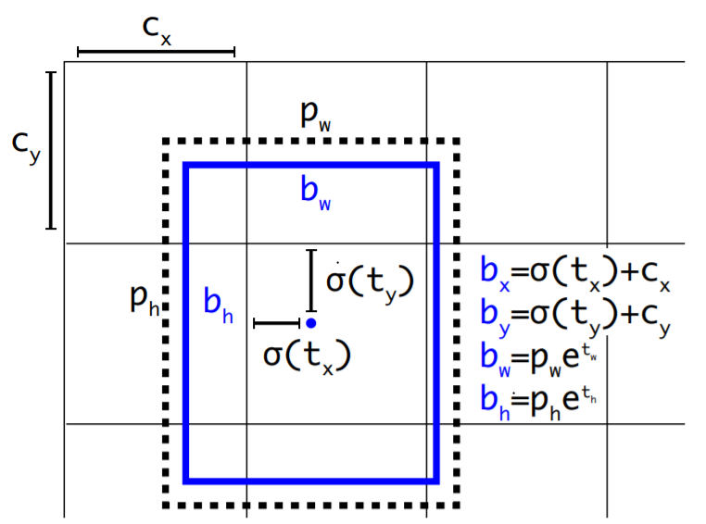
Problem with YOLO
YOLO calculates the prior box dimensions with K-means clustering over the training ground truth boxes.
The distance metric for this process is based on IoU scores, which is a huge computational blackhole.

Slide 12
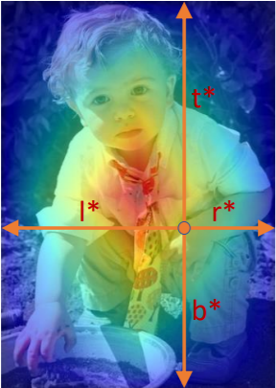
How FCOS tackles this problem
Unlike anchor-based detectors, FCOS directly regresses the target bounding box at some location on the feature map.
A location is considered a positive sample if it falls into the “center area” of some ground truth box.

Slide 13
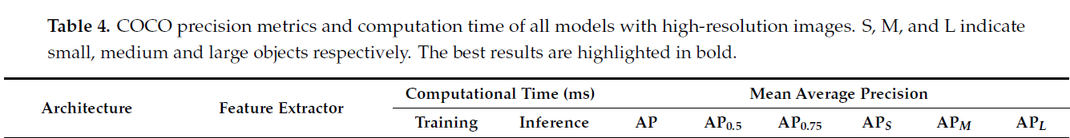
Tradeoff: Speed v/s Accuracy High-resolution images (1920x1280)
FCOS with ResNet50 as feature-extractor
Shows a training time of around 170ms, almost 10ms better than YOLO, and gets a mean AP of nearly 36
Performs extremely well on large sized objects
YOLOv3 with DarkNet53 as feature-extractor
Has a higher training time, but is faster during inference
Performs better for smaller objects, and gets an overall mAP of 31 (worse than FCOS)

Slide 14
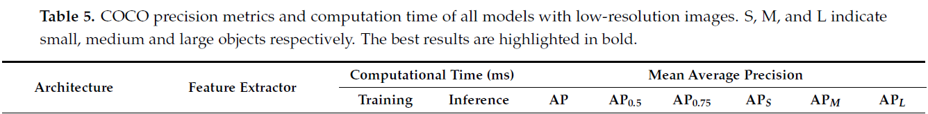
Tradeoff: Speed v/s Accuracy Low-resolution images (1920x886)
FCOS with ResNet50 as feature-extractor
Has a faster training time of around 75ms, and takes nearly the same time as YOLO during inference
Again outperforms YOLO for large objects, but worse otherwise
YOLOv3 with DarkNet53 as feature-extractor
Gets an mAP of 30, compared to 27 for FCOS
Training time closer to FCOS as compared to the situation of higher resolution images, better mAP on smaller objects

Slide 15
TESTS OF COMPARISON
We have sampled a set of images from the net and ran the FCOS and YOLO on each of the images. We have set the YOLO threshold at 50%.
We observe some generic differences between the models and also some very specific differences in specific conditions like low resolution, fog, dark images.
We will go over the different examples and also list down our observations for each of them. Let’s start!

Slide 16
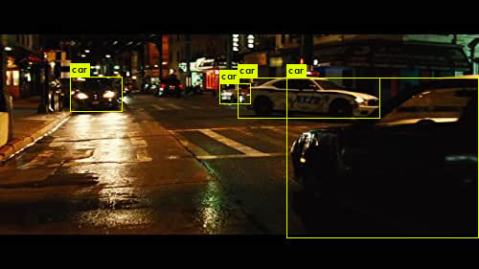
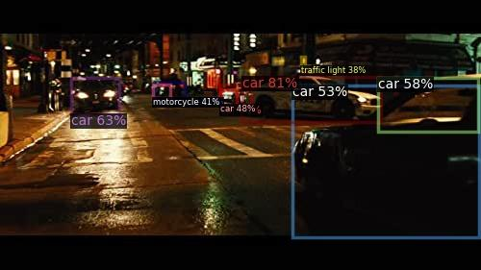
YOLO
FCOS
It is clear how both YOLO and FCOS can achieve really good level of predictions in dark images, with less light. In general, FCOS tends to over-identify the objects in the images. We see how it observes 2 instances of car for the same car and also identifies another car as a Motorcycle. Yolo also fails in this case, but it doesn't predict wrong. It just doesn't identify such smaller objects.

Slide 17
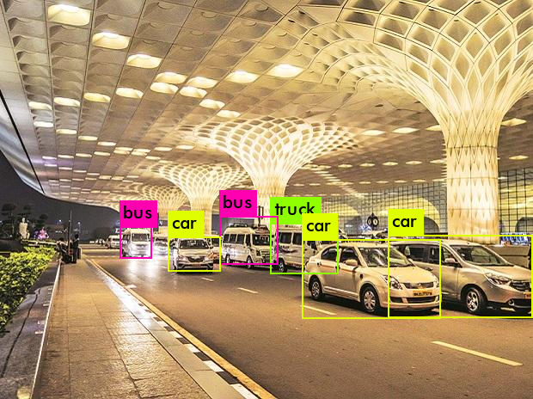
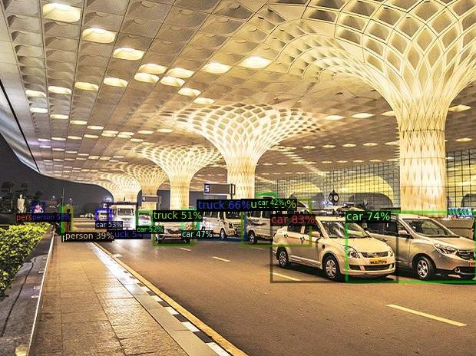
YOLO
FCOS
Both predict the objects which were occluded, by a box which probably covers the objects. Another observation is the fact that FCOS is highly scale invariant, and predicted even the smaller objects such as the background cars and the person

Slide 18
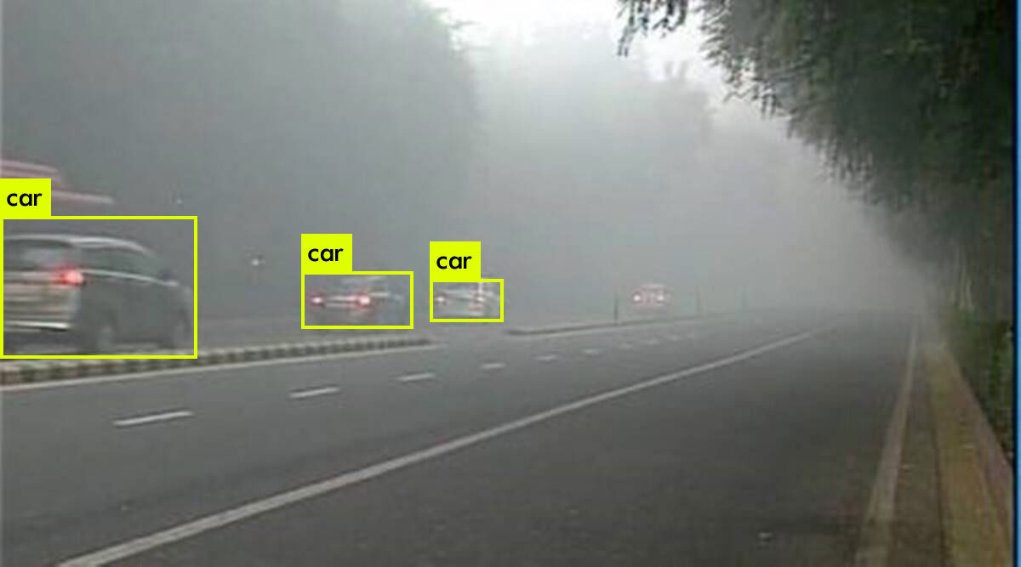
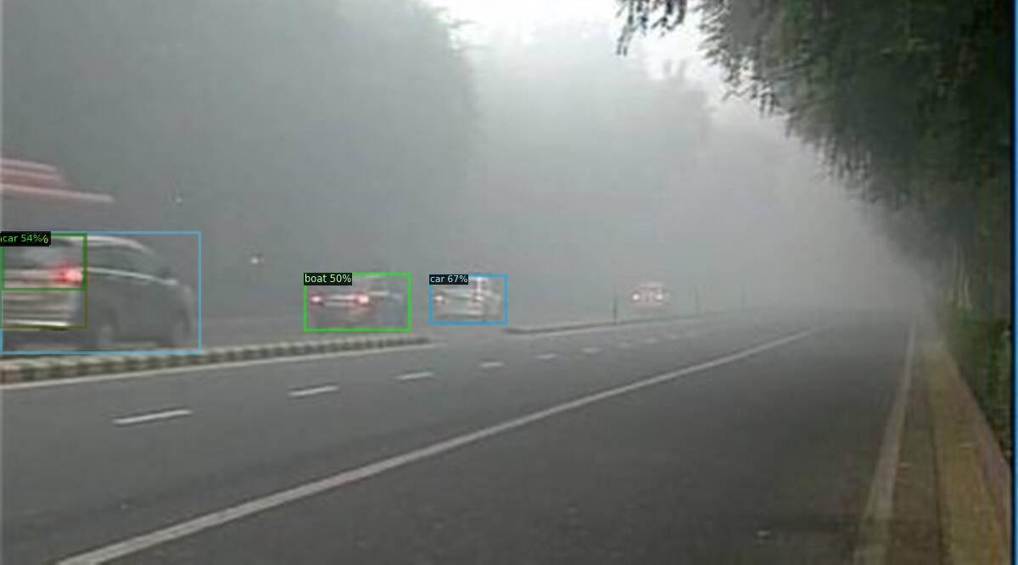
YOLO
FCOS
When images are foggy , FCOS sometimes overpredicts the objects while YOLO fails to detect objects. This has been observed in the above images along with the results on the next page. In case of large amounts of fog as in the rightmost car image, we can see that both models fall prey to noise occlusion, thus none of the models is able to detect the objects.

Slide 19
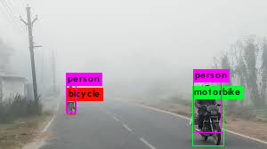
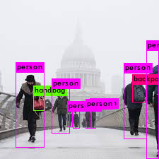
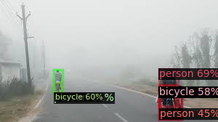
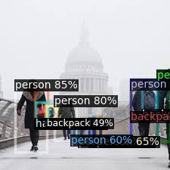
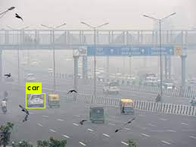
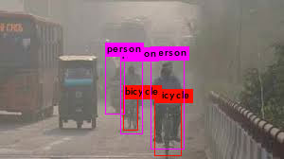
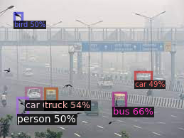
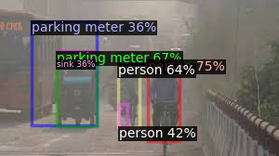
YOLO
FCOS

Slide 20
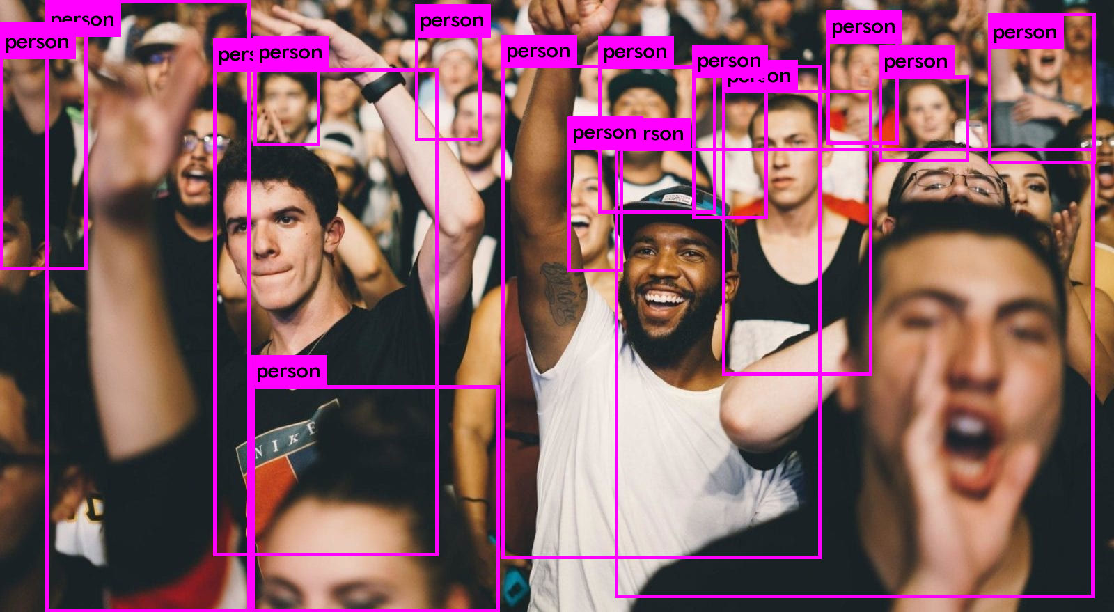
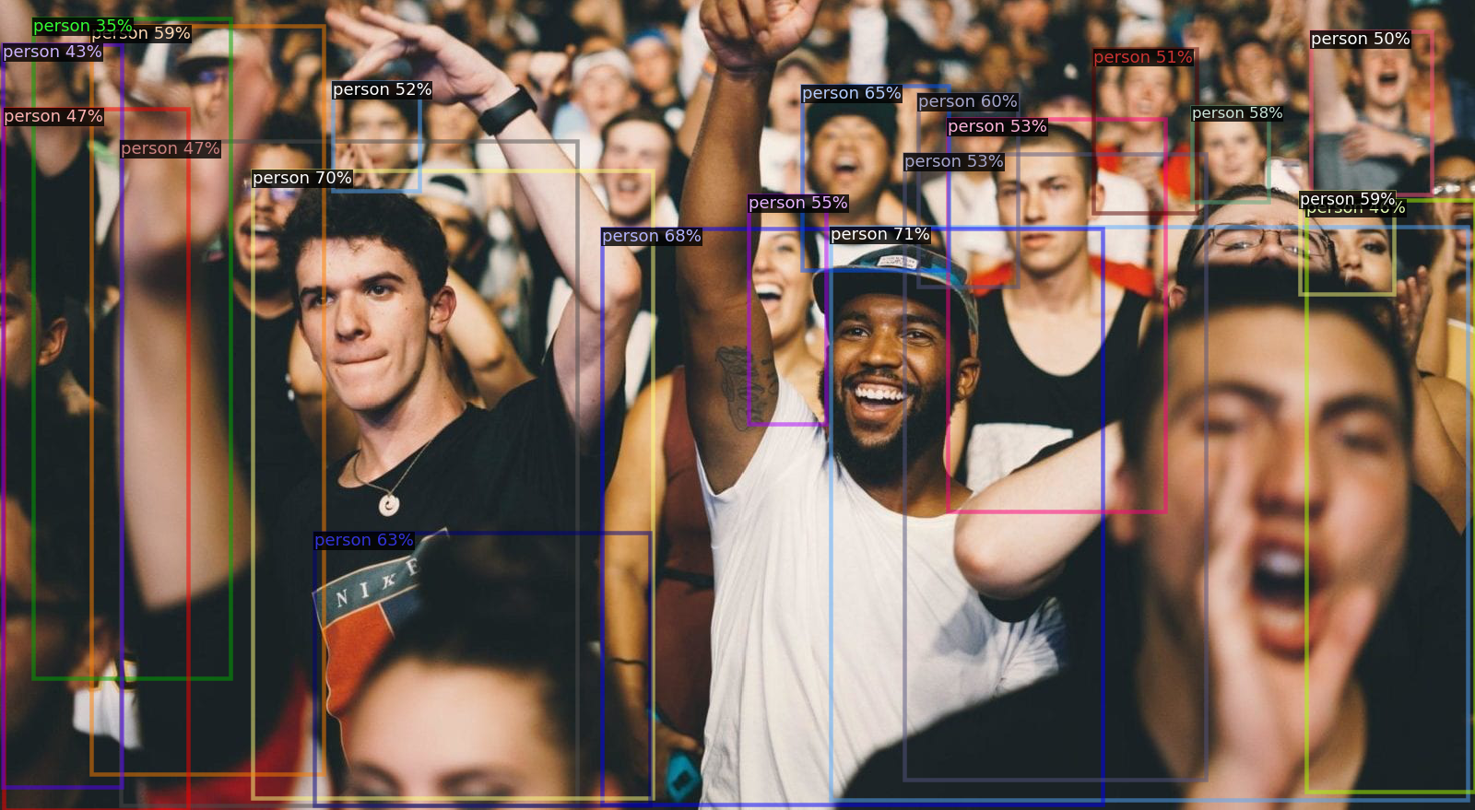
YOLO
FCOS
Both the models are extremely good at identifying the people and faces. This might be due to large training data sets for people’s faces. But for the same reason, we observe a shortcoming in FCOS. It sometimes misinterprets human features like arms and clothing to be a person in itself. Thus, it gives multiple predictions for the same object.

Slide 21
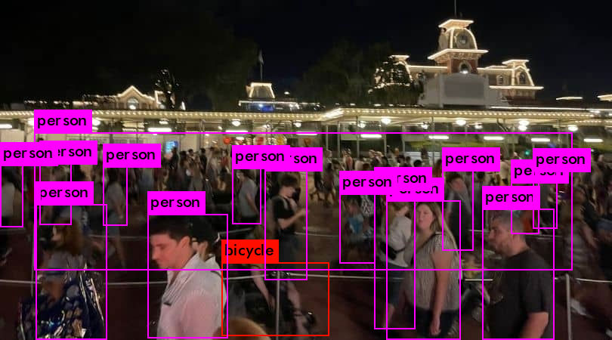
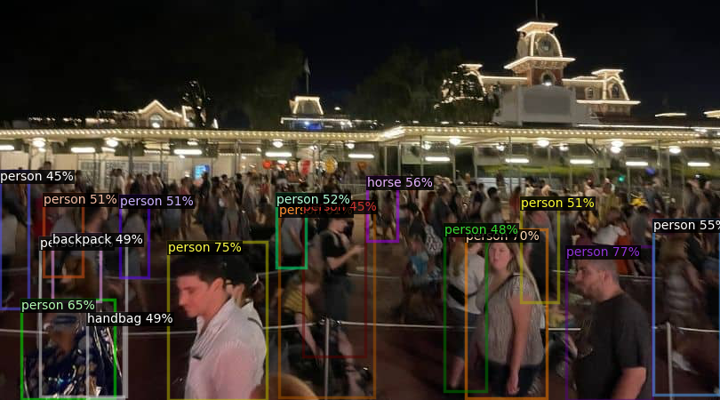
YOLO
FCOS
Here again, we see how both the models are really good at identifying at people. FCOS however, also identifies a lot more stuff and thus performs better in clustered images with large number of objects. Some examples in the next image also highlight the same.

Slide 22
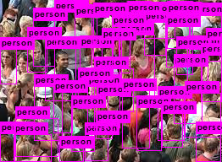
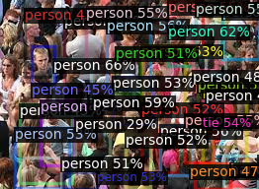
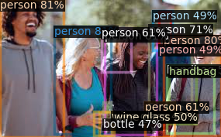
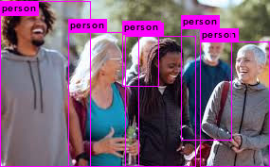
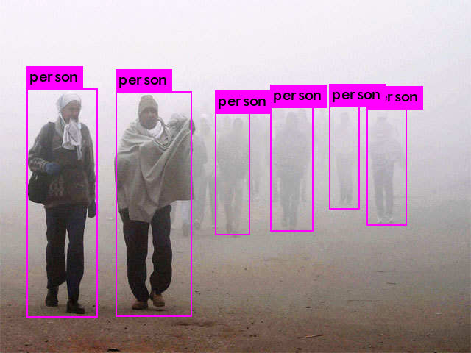
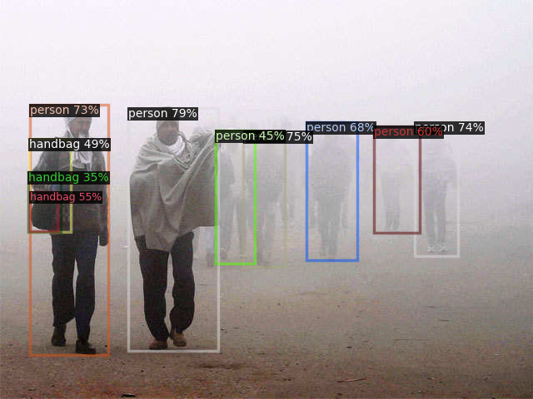
YOLO
FCOS

Slide 23
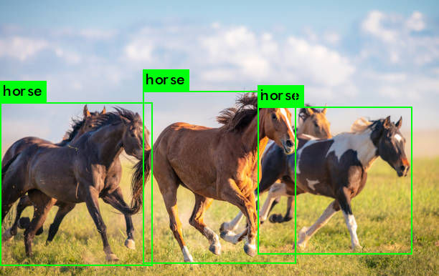
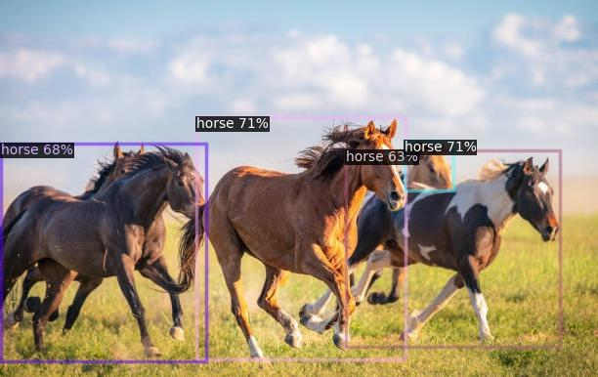
YOLO
FCOS
When objects other than people are more occluded, YOLO is unable to identify objects as compared to FCOS. For example, YOLO fails to identify the 4th horse identified by FCOS.( Note that the 5th horse ,behind the first from left, was completely undetected by both due to severe obstruction). This has further been seen in the next image.

Slide 24
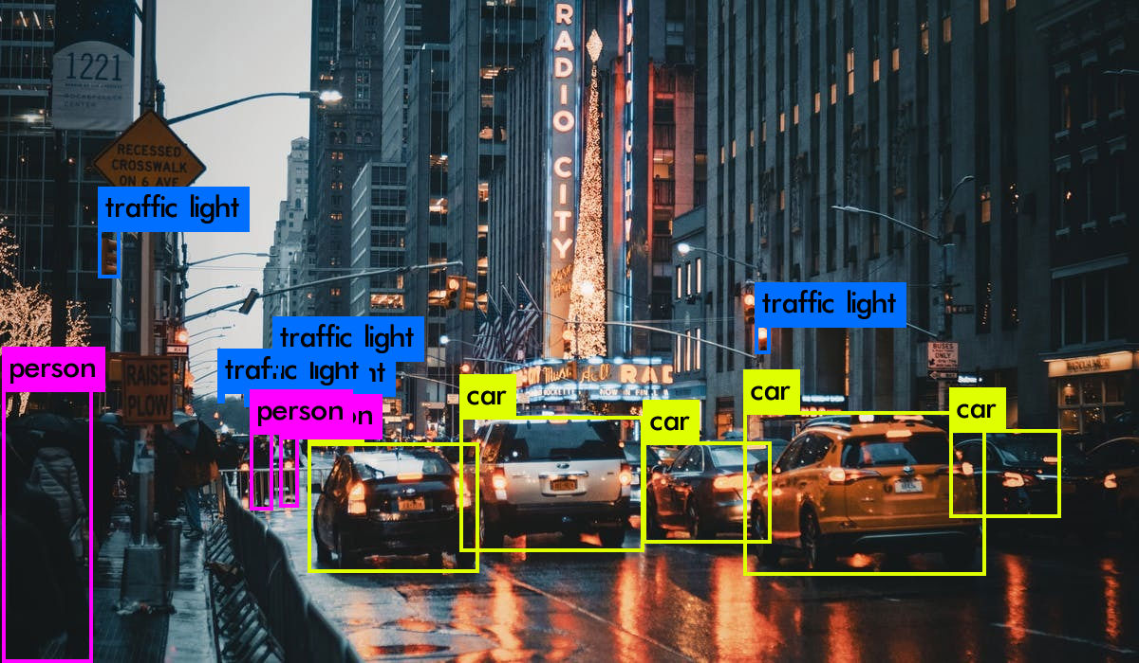
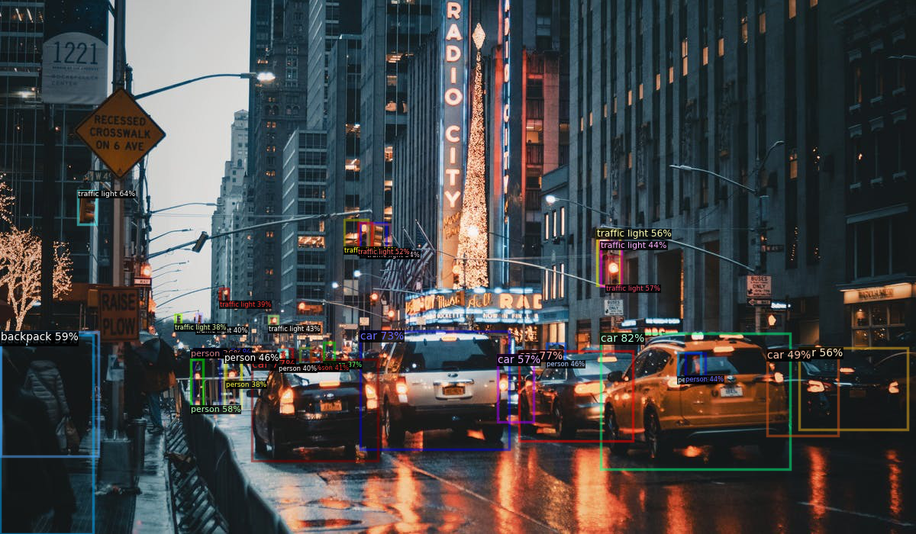
YOLO
FCOS
Again, FCOS, detects more objects , including very small objects , as compared to YOLO. You might want to zoom into the images to see the bounding boxes more clearly.

Slide 25
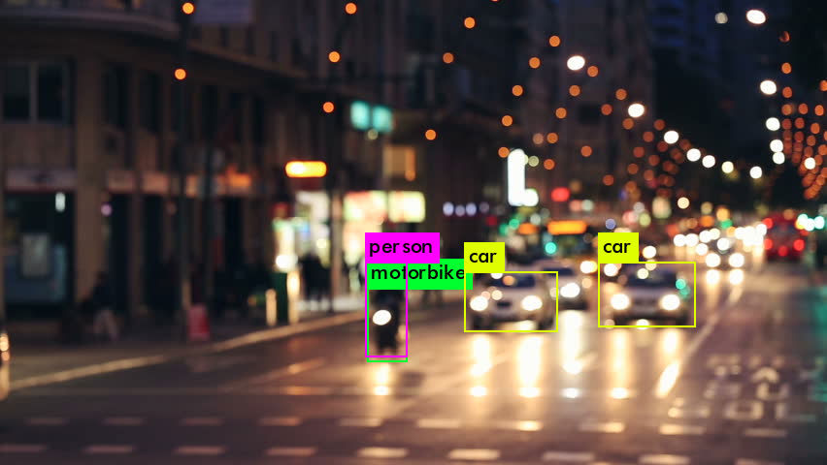
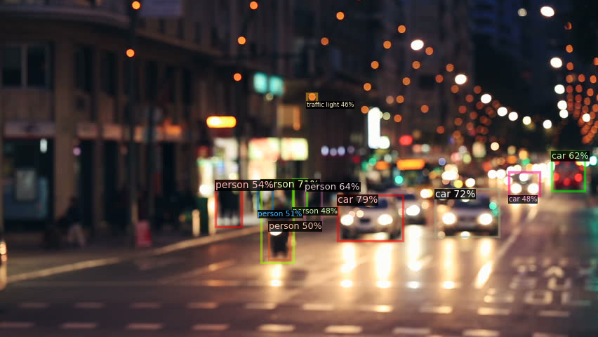
YOLO
FCOS
We now come to the low resolution images. We see the trends being followed here as well. The YOLO model is under-detecting while the FCOS model is over-detecting. YOLO is only able to detect large objects like cars and bikes, while FCOS also detects a lot of people. We see this in the following images as well. Sometimes YOLO doesn't detect anything at all.

Slide 26
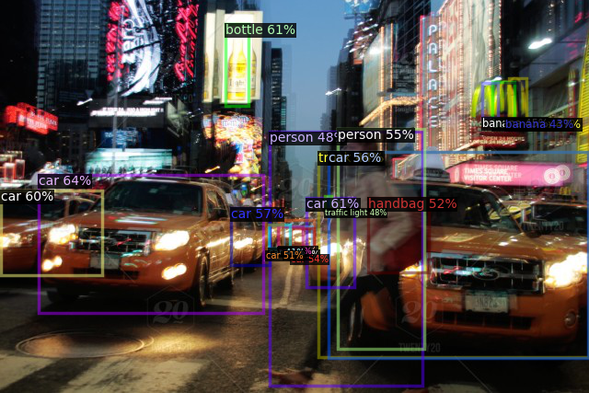
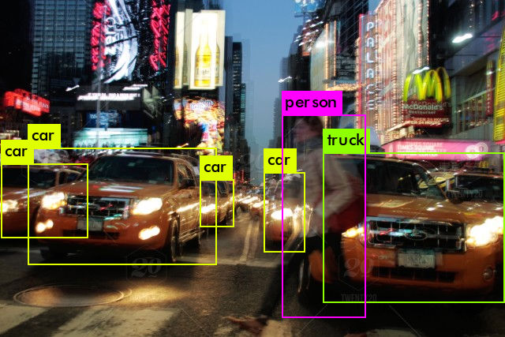
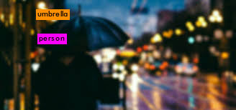
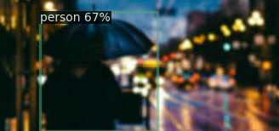
YOLO
FCOS

Slide 27

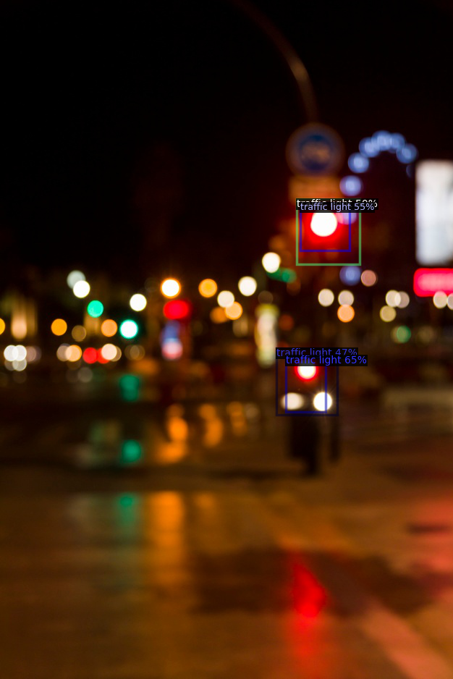
YOLO
FCOS

Slide 28
Conclusions
In this project we have implemented the YOLO model and trained on a custom dataset. The results are displayed above and also in the attached ipynb file. We then went to on to compare the performance of an anchor-based model like YOLO to a state-of-the-art anchor-free model like FCOS.
For comparing the two models, we have used the pretrained versions and you can replicate our results by following the procedure mentioned in the README.txt, to install both of them on your system as well.
We finally reach the conclusion that both the models are really comparable in their detection capabilities, but the FCOS is faster and also seems to perform better in case of noise and low resolution conditions

